Slide 1
Writing Workshop
OUC
Class 3

Slide 2
Class Objectives
Assign verbal practice passages to each student!
http://www.lightspeedmagazine.com/fiction/exhalation/
Pick any passage (paragraph must be over 4 sentences minimum!) from the short story and practice reading it out loud
Each class, you will recite the same passage out loud to the class to practice your verbal fluency!
Message me if you have any questions! What does this word mean? How do I pronounce this word? Where are the natural pauses in the sentence? Don’t be shy!
Review Parts of Speech, Subjects/Predicates, and Direct/Indirect Objects
Sentence Structures
Simple vs Compound
Phrases vs Clauses
Independent vs Dependent Clauses
Complex Sentence
Complex-Compound Sentences
Listening Practice
Homework

Slide 3
Parts of Speech
Category to which a word is assigned in accordance with its syntactic functions.
In English, there are 8 main parts of speech:
Noun – a person, place, or thing
Adjective – describes or modifies a noun
Verb – an action, state, or occurrence
Adverb – describes or modifies a verb
Determiner -- words that make it clear what or who the noun refers to
Preposition -- words that indicate relationships between other words
Conjunction -- word used to coordinates or connect words, clauses, or sentences
Interjection – word that expresses a spontaneous feeling and occurs as an utterance on its own

Slide 4
Nouns
Noun | Definition | Examples
common noun | generic person, place, or thing | chair, table, mountain, house, person, dog, cat, cake, carrot
proper noun | name used for a specific or individual person, place, or thing, and denoted by capitalizing the initial letter | Jeremy, Avengers, Harvard, France, Spock, Yellow Mountain
pronoun (possessive, demonstrative, reflexive, relative, indefinite, expletive) | word used to replace a noun or a noun phrase | he, she, it, this, you, I, me, us, we, they, them, everybody, who, that, which, whose

Slide 5
Adverbs
Adverb | Examples
place | off, abroad, everywhere, here, out, back, behind, down
time | everyday, daily, now, yesterday, tomorrow, today, tonight, then
degree | very, quite, too, extremely, absolutely, almost, barely, certain
manner | cheerfully, happily, efficiently, slowly, badly, sadly, quickly
frequency | always, sometimes, often, usually, frequently, typically
Determiners
Determiner | Examples
article | a/an, the
possessive | his, her, my/mine, your, its, our, their
demonstrative | this, that, these, those

Slide 6
Conjunction
Conjunction | Definition | Examples
coordinating | join words, clauses, or sentences | FANBOYS (for, and, nor, but, or, yet, so)
correlative | pairs of words that work together | either/or, neither/nor, not only/but also
subordinating | join independent and dependent clauses | because, since, as, although, though, while, whereas

Slide 7
Subject and Predicates
A sentence can be divided into two main parts:
Subject: noun or pronoun that does or perform the verb
Predicate: verb + rest of the sentence
Direct & Indirect Object
Direct and Indirect Objects are optional parts of the PREDICATE of a sentence
Direct Object: the thing that the subject acts upon
Indirect Object: recipient of an action; the recipient of the direct object

Slide 8
What is a sentence?
A sentence is a SUBJECT + PREDICATE that expresses a complete idea
THREE TYPES OF SENTENCES:
Type | Definition
Declarative | statement or fact
Interrogative | question
Imperative | command

Slide 9
Simple vs Compound Sentence
Simple sentences contain ONE independent clause
Compound subject = more than one noun performing the same predicate(s)
Compound predicate = more than one predicate performed by the same subject(s)
As long as the subject or compound subject is linked to the same predicate or compound predicate, it counts as a simple sentence
Compound sentences contain n-independent clauses and joined by conjunctions
Examples: Can you figure out if the sentences below are simple sentences or compound sentences?
I visited the beach and got a really bad sunburn
The lizard rested on a rock.
Jenny put an extra dash of ginger in the cookie batter.
The mosaic tile is so beautiful; it’s made with melted glass.
The witches stirred their cauldrons with long-handled birch sticks.
Juniper went kayaking in the ocean, and she saw a humpback whale.

Slide 10
Simple vs Compound Sentence
Simple sentences contain ONE independent clause
Compound subject = more than one noun performing the same predicate(s)
Compound predicate = more than one predicate performed by the same subject(s)
As long as the subject or compound subject is linked to the same predicate or compound predicate, it counts as a simple sentence
Compound sentences contain n-independent clauses and joined by conjunctions
Examples: Can you figure out if the sentences below are simple sentences or compound sentences?
I visited the beach and got a really bad sunburn. simple
The lizard rested on a rock. simple
Jenny put an extra dash of ginger in the cookie batter. simple
The mosaic tile is so beautiful; it’s made with melted glass. compound
The witches stirred their cauldrons with long-handled birch sticks. simple
Juniper went kayaking in the ocean, and she saw a humpback whale. compound
compound predicate
conjunction
conjunction

Slide 11
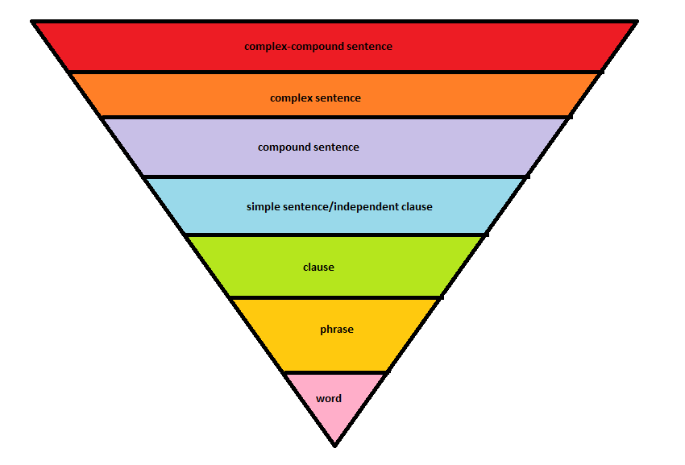
Grammatical Hierarchy

Slide 12
Phrases & Clauses
What is a phrase?
a grammatical unit consisting of at least two words
does NOT contain a subject + predicate and CANNOT stand alone
can work as a noun, adjective, or adverb
Example: I stopped believing in Santa Claus (noun) when my mother took me to see him in a department store (adverb) and he asked for my autograph.
What is a clause?
a grammatical unit that contains a subject + predicate
whether it can stand alone depends on if it is an INDEPENDENT or DEPENDENT clause (more on this later)
Independent clauses are also known as SIMPLE SENTENCES
clauses can work as a noun, adjective, or adverb

Slide 13
Independent vs Dependent Clauses
Independent Clause (aka Simple Sentence)
Subject + Predicate = Complete Idea
CAN stand alone as a sentence
Dependent Clause
Subject + Predicate =/= Complete Ideal
CANNOT stand alone and MUST be attached to an independent clause
Usually attached to a dependent word which is usually a subordinating conjunction
Can act as a noun, adjective, or adverb
Examples
Tara ate a cheese roll after she watched the news.
Even though his mother was a driving instructor, my cousin failed his driving test six times.
A computer once beat me at chess but was no match for me at kick boxing.
I cannot remember what I said last night (noun).
My dog, who usually refuses to go near the water (adjective), dived in the canal to chase a squirrel.
He lost his double chin after he gave up beer (adverb).

Slide 14
Complex Sentences
independent clause + dependent clause(s)
Examples:
Keeping her speech short, the Mayor promised to improve roadways and bridges because she wanted to appeal to as many of her voters as possible
No matter how many heavy objects the researchers put on top of its tank, the octopus kept escaping
After eating lunch at The Cheesecake Factory, Tim went to the gym to exercise
Opinionated women are given disadvantages in societies that privilege male accomplishments (relative clause, adjectival)
The woman who taught Art History 210 was fired for stealing school supplies
relative pronoun
relative pronoun
(relative clause, adjectival)

Slide 15
Compound-Complex Sentences
independent clause(s) + dependent clause(s)
Examples
After the two soccer players lost their game, they joined their other teammates for lunch, and they went to the movies
The man believed in the system, and he knew that justice would prevail after the murderer was sent to jail
Though Mitchell prefers watching romantic films, he rented the latest spy thriller, and he enjoyed it very much
Laura forgot her friend's birthday, so she sent her a card when she finally remembered
after, though, when = dependent word signifying the start of the dependent clause
and, so = coordinating conjunction

Slide 16
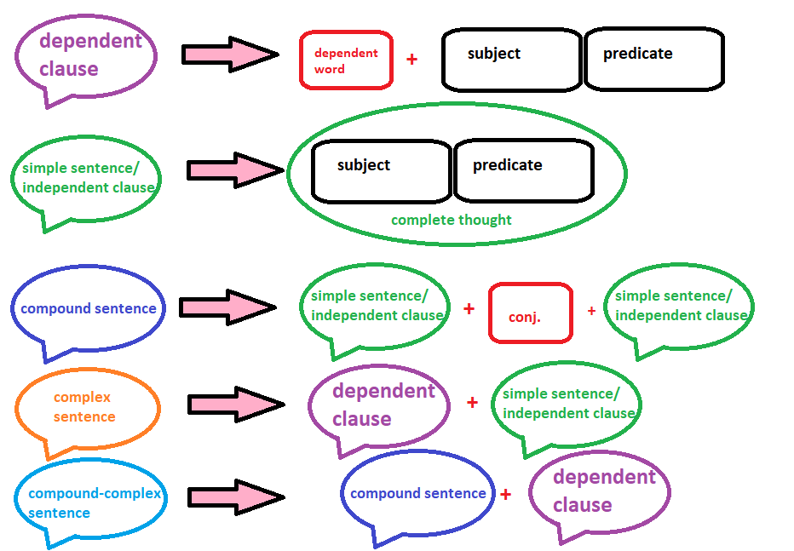
Recap

Slide 17
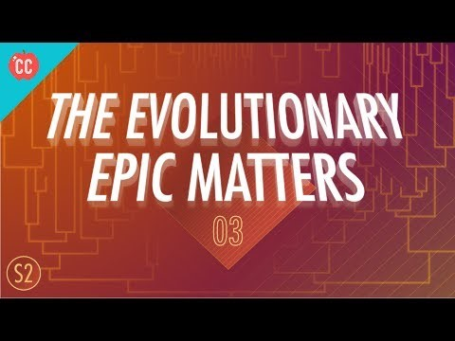
Listening Practice!
https://youtu.be/IiP2y20e8Xc

Slide 18
Vocabulary 9/7
Consider, verb.
To think carefully about (something), typically before making a decision.
Example: each application is carefully considered on its merits
Eschew, verb.
deliberately avoid using; abstain from
Example: family dinners are stressful enough, so we have all collectively agreed to eschew talking about politics.
Deliberate, adj. & verb.
done consciously and intentionally (adj.)
engage in long and careful consideration (v.)
Example: that was a deliberate (adj.) attempt to provoke conflict
Example: the judge will deliberate (v.) the case and announce the verdict tomorrow

Slide 19
Homework 9/7
Write 5 unique sentences using each of the 3 vocabulary words from today.
Tell me about the last book you read for fun. What was the plot? Where was it set? Who are the characters? Practice using all of the sentence structures we covered today:
Simple Sentence
Compound Sentence
Complex Sentence
Compound-Complex Sentence
Practice your verbal passages for the next class. You will read them out loud to the class.
Thanks!

